Slide 1
Instructions
Explain to the Cubs that on each slide there will be an action. If that action appears on a coloured square for their Six, they should do that action on screen.
For example, the first action is for blue Six to wave, followed by a thumbs up from Red Six, point from Yellow and Green Six then put their little finger up.
As the slides progress, multiple Sixes are given an action.
The slide set is built for a Red, Green, Blue and Yellow Six. You can easily update for your own Sixes.

Slide 2
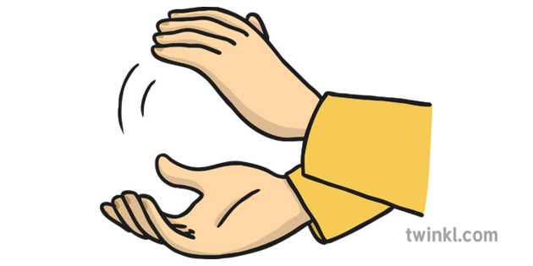
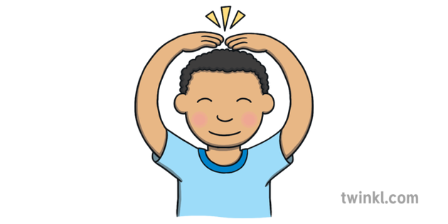
Six Action

Slide 3
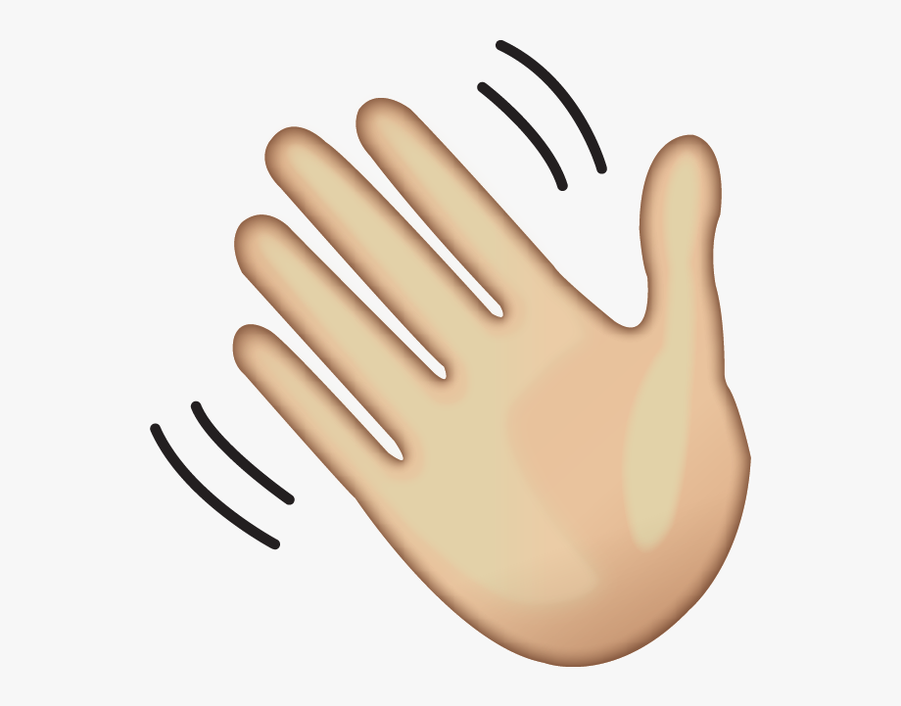

Slide 8
More active

Slide 9
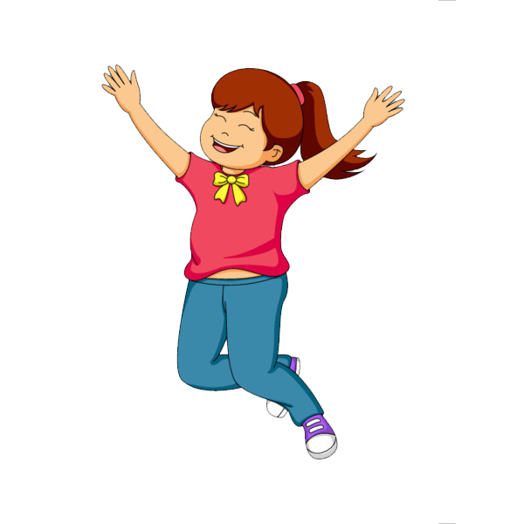
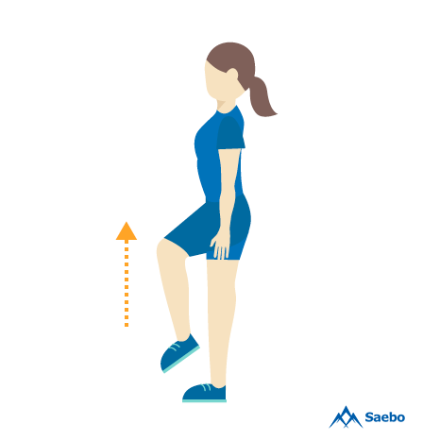

Slide 10
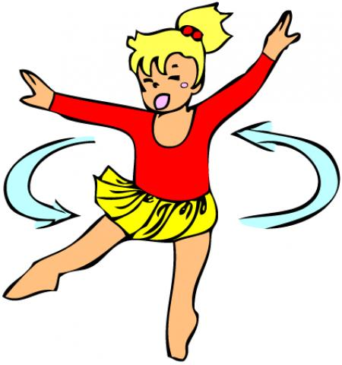
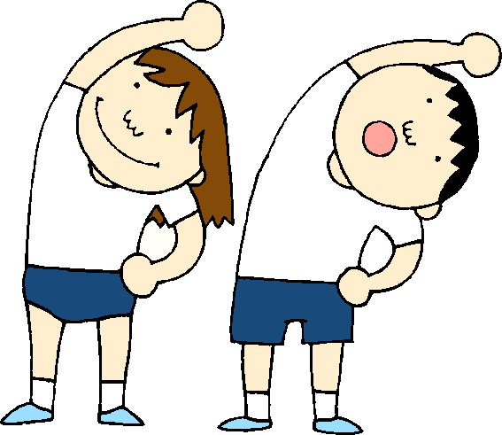

Slide 11
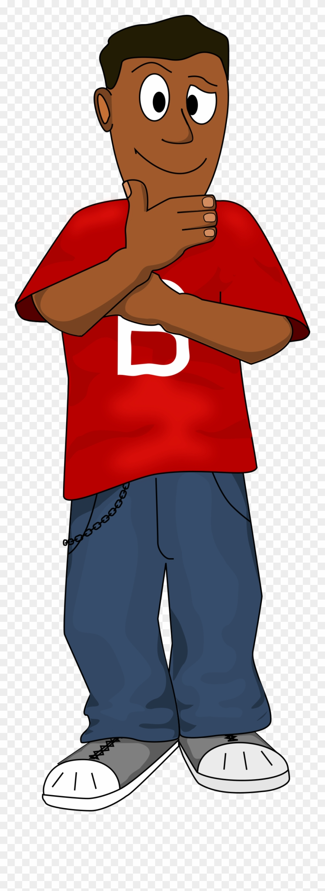
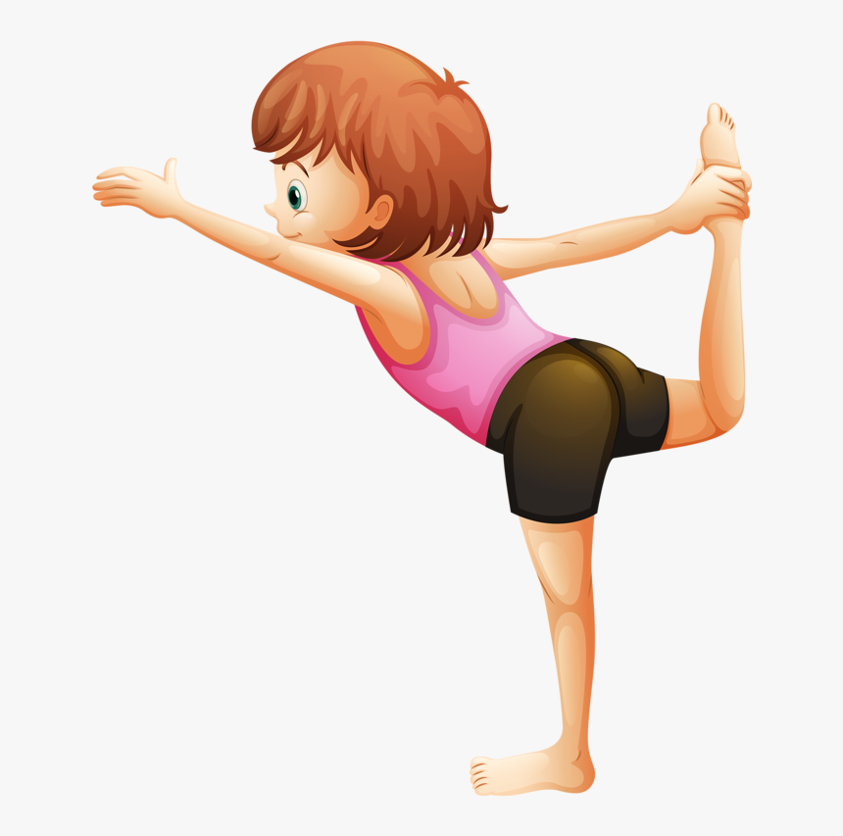

Slide 12
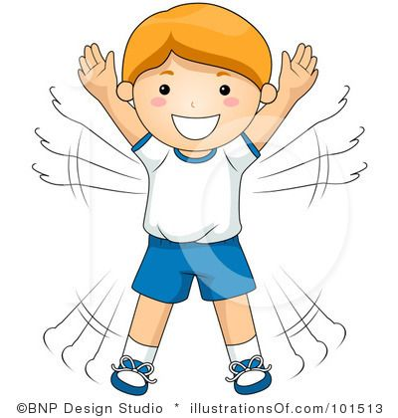
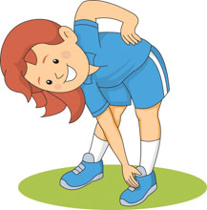

Slide 13
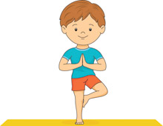

Slide 15
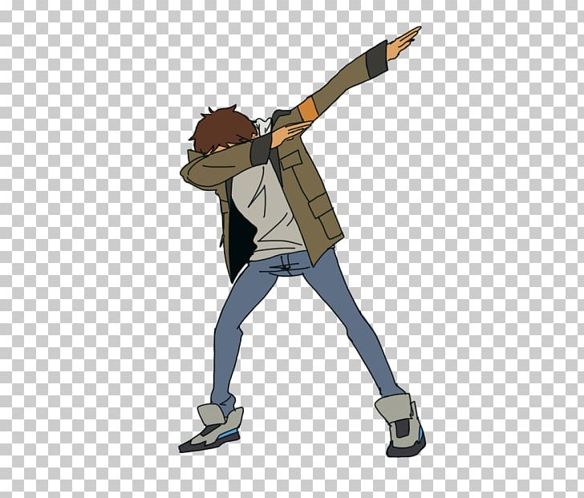

Slide 20
Faster

